Slide 1
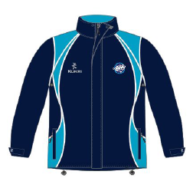
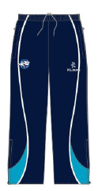
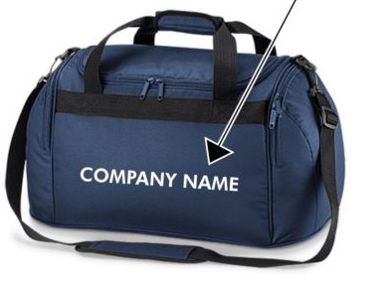
Abbey Netball Club Kit 15/16
Navy fitted T-Shirt £17.50
White Base layer £22
Navy Hoody £22
Tracksuit Top £39
Tracksuit Bottoms £30
Kit Bag £18

Slide 2
Abbey Netball Club Kit 15/16
Order Form
Name | Team/Age Group
Item | Sizes available | Size req | Name to print | Quantity | Price
Navy Hoody (Abbey logo embroidered on left breast) | (size name:chest size) S(35’’/37’’), M(38’’/40’’), L(41’’/43’’), XL(44’’/46’’) |  |  |  | £22
Base Layer (Abbey NC printed on sleeve) | (size name:chest size) XXS(28’’/30’’), XS(32’’/34’’), S(36’’/38’’), M(40’’), L(42’’) |  |  |  | £22
Navy T shirt (fitted) (Abbey logo embroidered on left breast & your name printed on back) | XS (8/30’’), S (10/32’’), M (12/34’’), L (14/36’’), XL (16/38’’) Un-fitted unisex t shirt also available please ask for details... |  |  |  | £17.50
Tracksuit Top (Abbey logo embroidered on left breast & ABBEY NETBALL printed on back) (approx 12 wk lead time) | (size:chest size): 4 (26’’), 6 (28’’), 8 (30’’), 10 (32’’), 12 (34’’), 14 (36’’), 16 (38’’), 18 (40’’) |  |  |  | £39
Tracksuit Bottoms (Abbey logo embroidered on left) (approx 12 wk lead time) | (size:waist size): 4 (22’’), 6 (24’’), 8 (26’’), 10 (28’’), 12 (30’’), 14 (32’’), 16 (34’’), 18 (36’’) Inside leg length: (short)28’’, (reg)30’’, (long)32’’, (xlong)34’’, (xxlong)36’’ | (Waist & Leg) |  |  | £30
Kit Bag (ABBEY NETBALL & your name embroidered) |  |  |  |  | £18
Total amount due |  |  |  |  | £
How to order | Sizing | Order deadline / payment
Complete the order form above and send it to abbeynetballoxford@gmail.com Please state: SUBJECT: Kit Order & Your name Please pay online. We will confirm your order by email. | Unfortunately we do not have a stock of the tabled items for people to try on and determine size. With this in mind, please can we ask that club members allow other members to try on their kit, so they can gauge what size they need. | Order & payment deadline: 16.10.15 ORDER FORMS ONLY BY EMAIL NO PAYMENT - NO ORDER Payment Method: Online: Please use your name and kit as the payee reference (e.g. ETasker Kit) A/C no: 70101478, Sort code: 200109.

